Slide 1
Purchase Amount Prediction Using Black Friday Data

Slide 2
Learnings from the Project
Using Mode to replace Null Value
Using Ordinal data of Age as Continuous Data
Exploring Data and Feature Selection using ANOVA and Chi-Sqaure

Slide 3
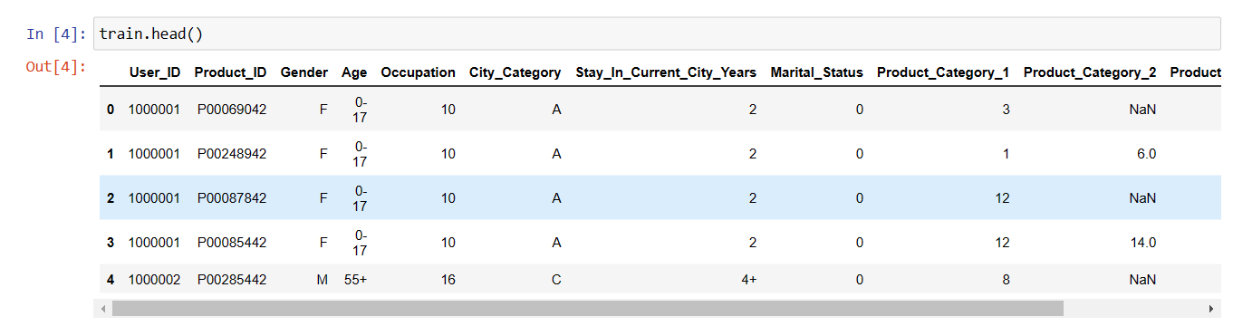
DataFrame

Slide 4
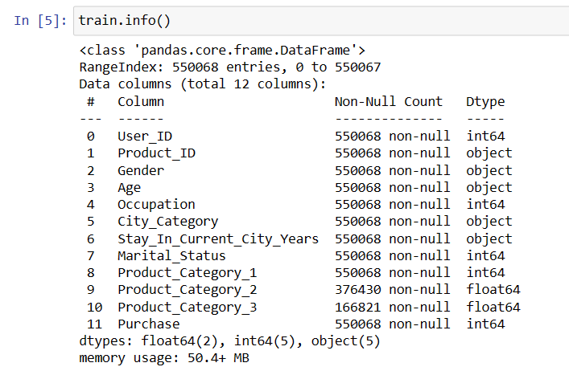
DataFrame

Slide 5
Feature Engineering

Slide 6
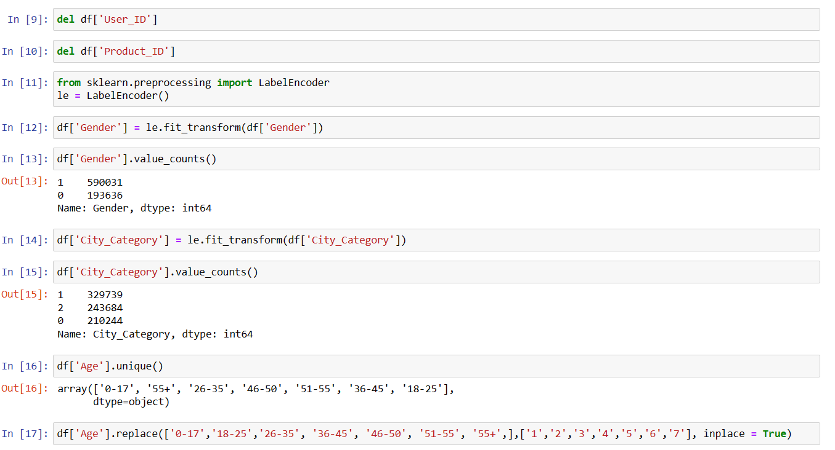

Slide 7
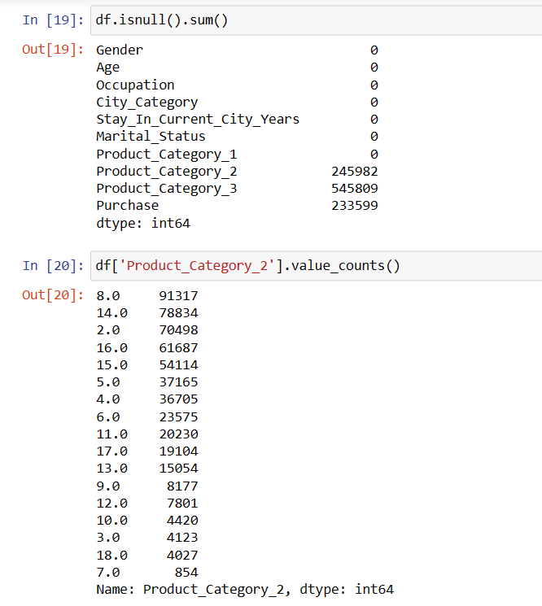

Slide 8
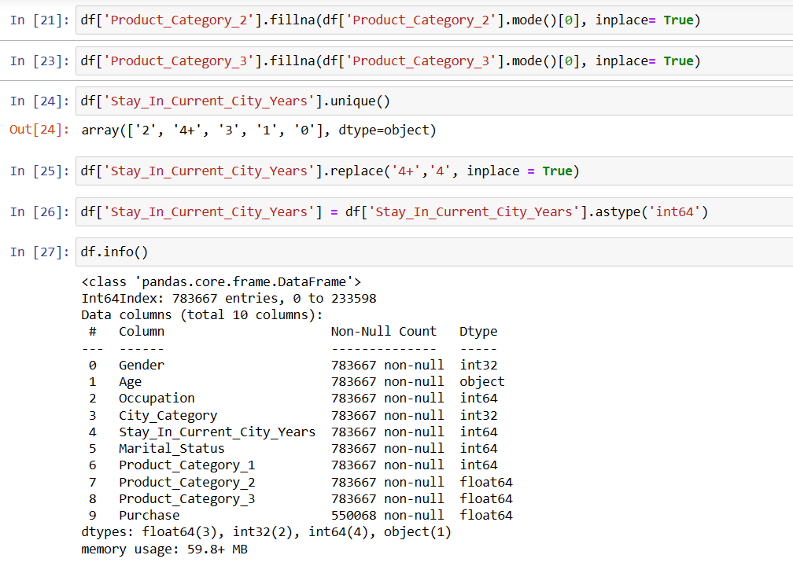

Slide 9
Exploratory Data Analysis

Slide 10
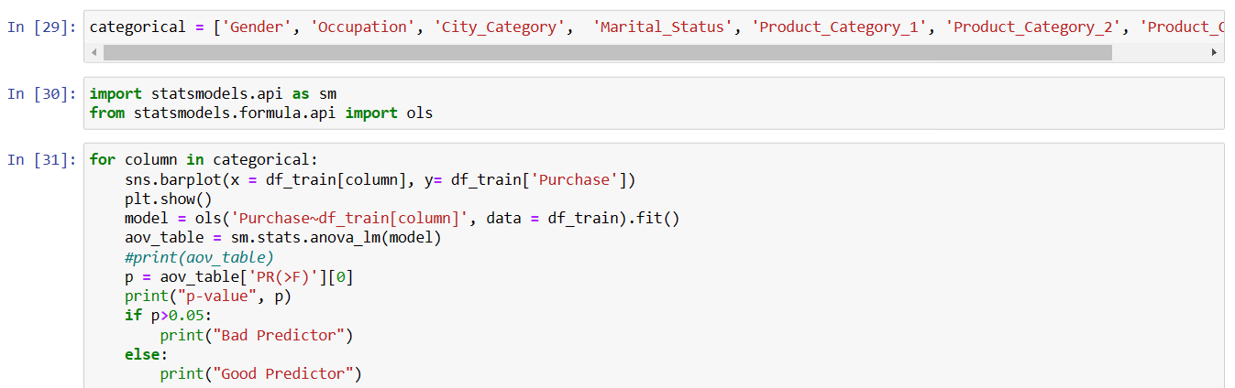

Slide 11
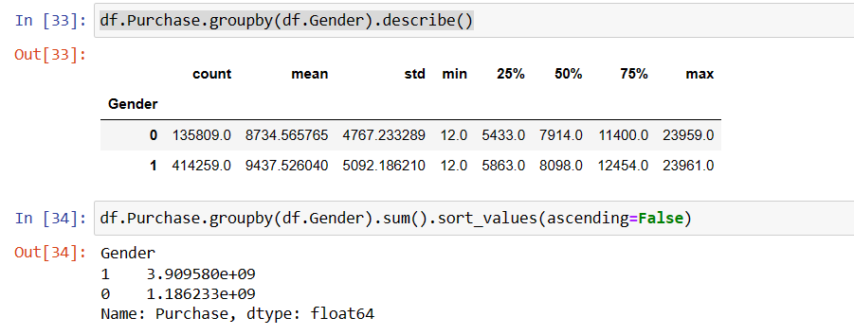
Gender Description

Slide 12
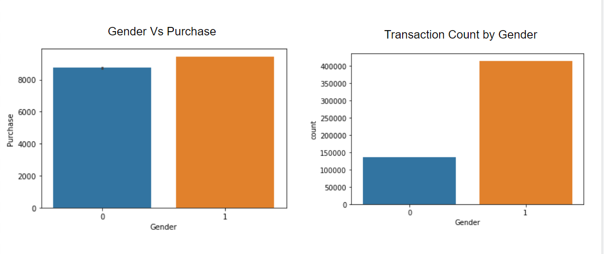
p-value 0.0 Good Predictor
We can see men purchase value is higher along with more number of transactions

Slide 13
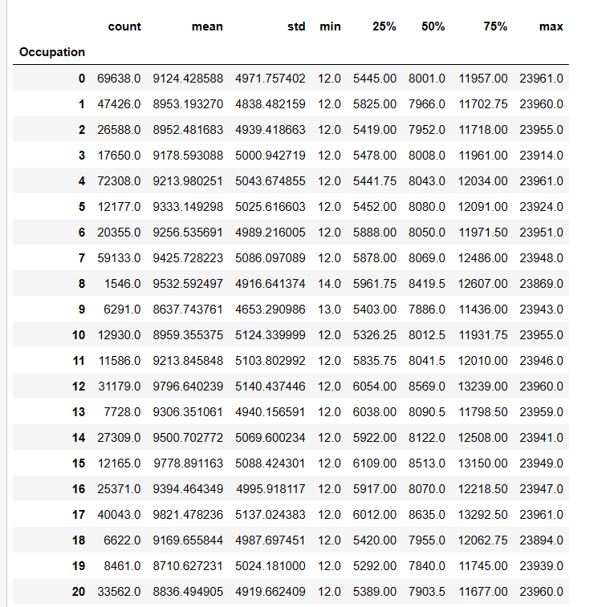
Occupation Description

Slide 14
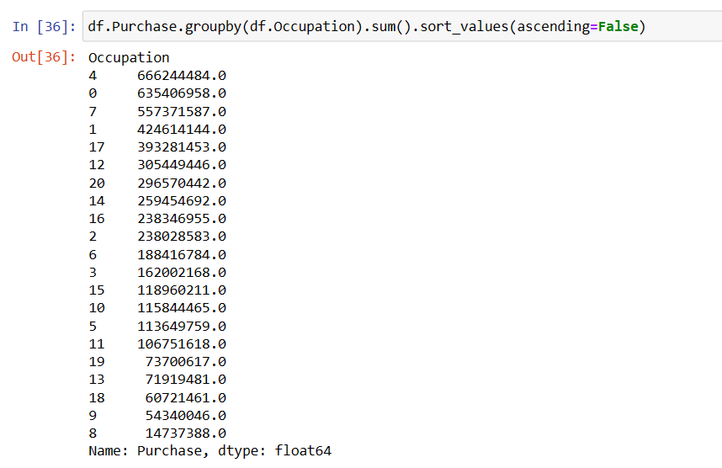
Occupation Description Total Purchase Value

Slide 15
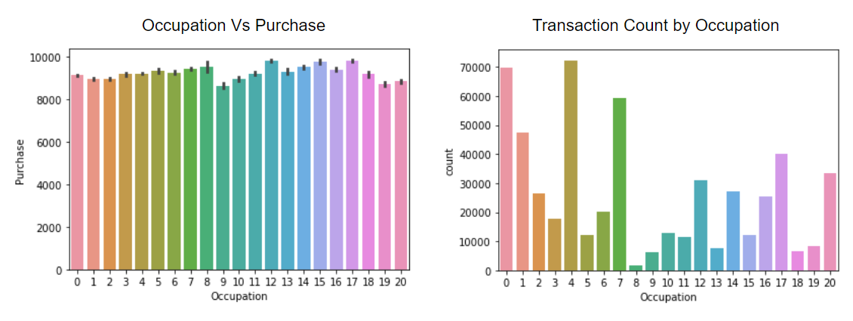
p-value 7.259684172672924e-54 Good Predictor
We can see avg.purchase ranges between 8000-10000 considering all types of occupation. Purchases made by occupation 0,1,4,7 are highest.

Slide 16
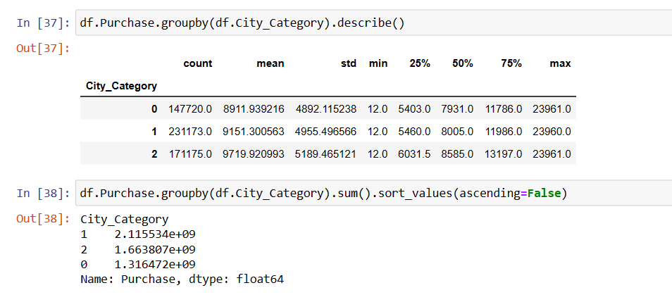
City Wise Description

Slide 17
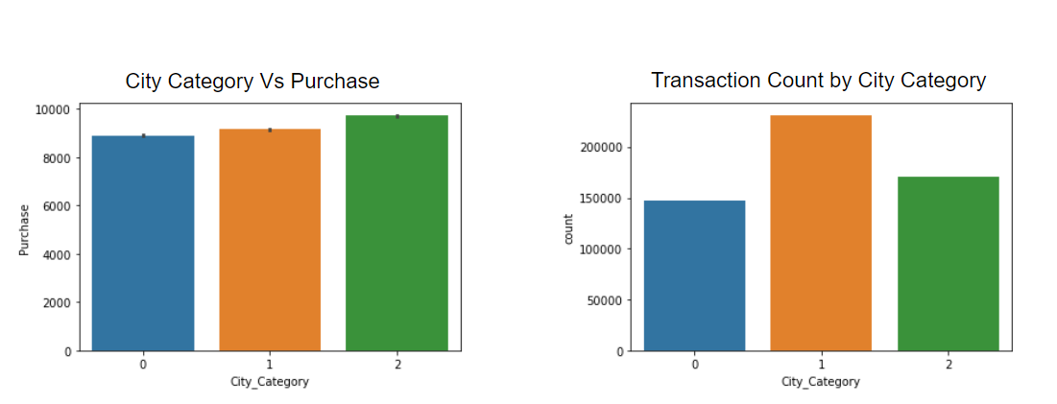
p-value 0.0 Good Predictor
Purchase avg.value ranges ranges between 8k tp 10k across all cities. We can see City Category 1 has highest amount of purchase

Slide 18
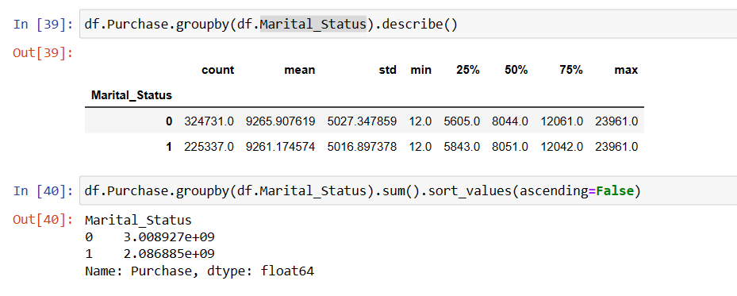
Marital Status Description

Slide 19
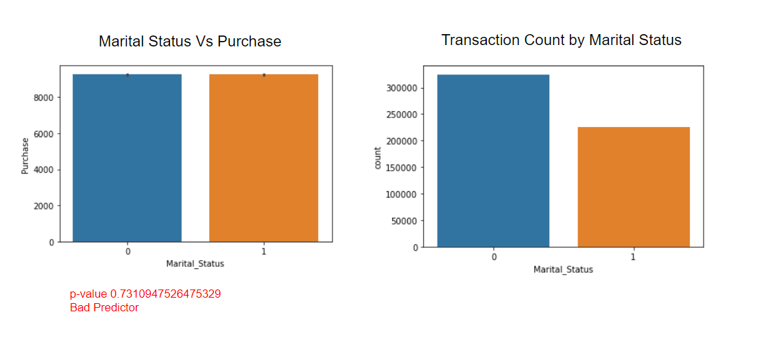
Unmarried people are making higher number of purchases

Slide 20
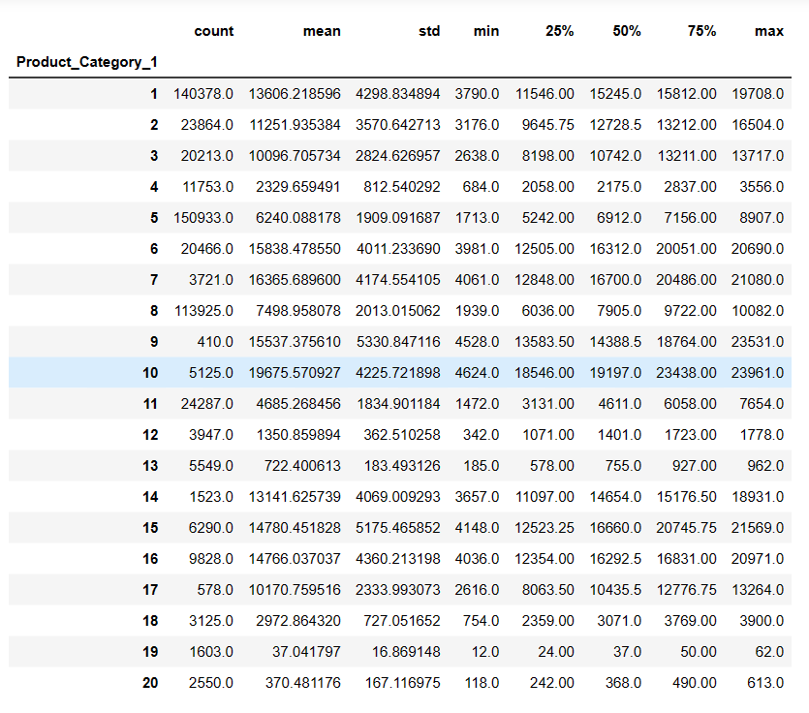
Product CAT 1 Description

Slide 21
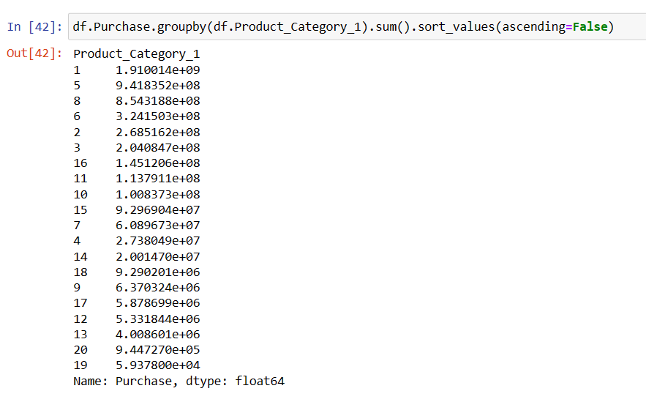
Product Cat_1 Description Total Purchase Value

Slide 22
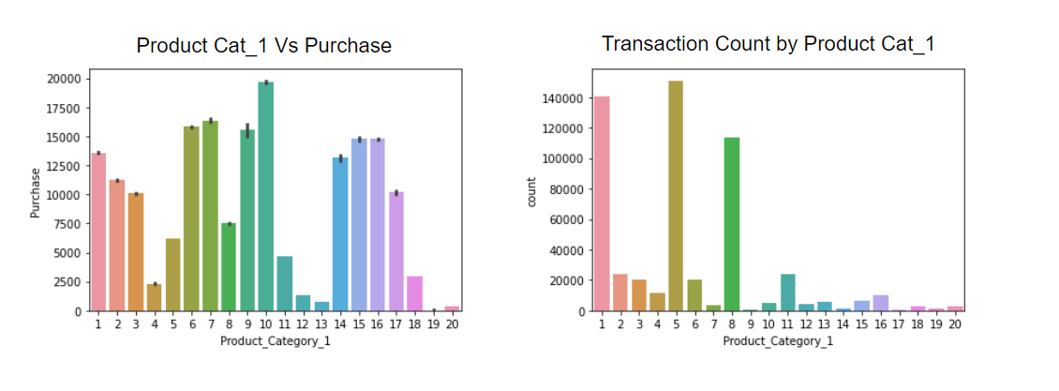
p-value 0.0 Good Predictor
Product 1,5,8 are highest selling. Company should look more into product 1 and 8. If possible company should also try to sell product 2 and 3 as they can lead to significant improvement in revenue, also seeing a better traction compared some of the other products.

Slide 23
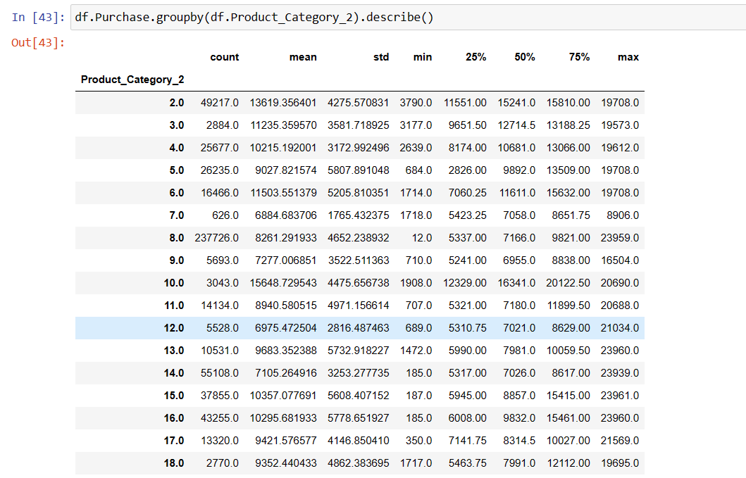

Slide 24
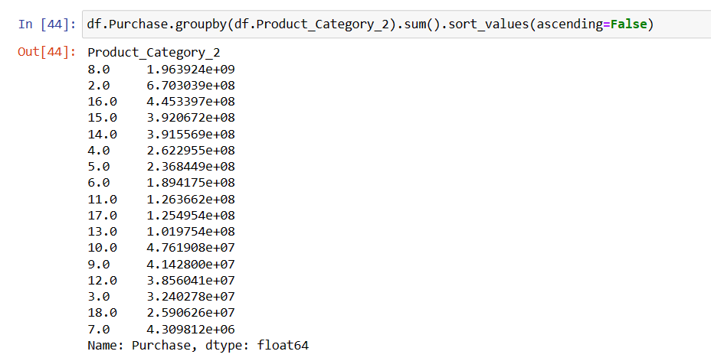

Slide 25
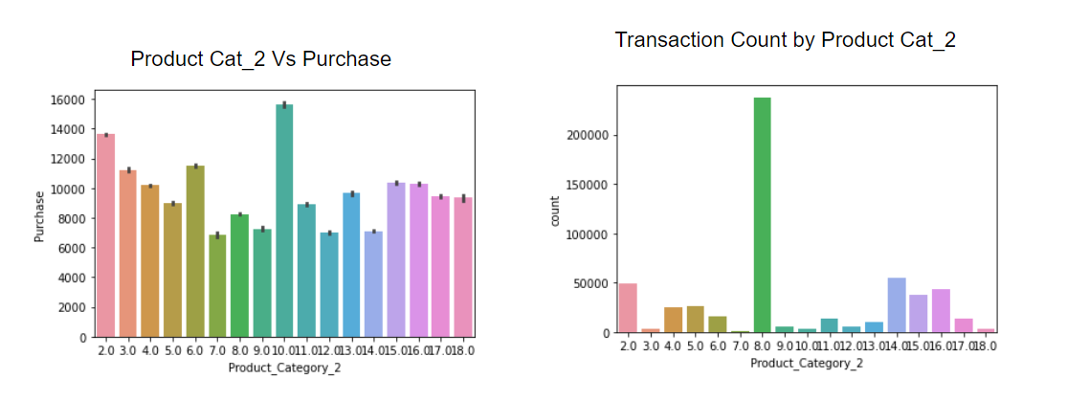
p-value 0.0 Good Predictor
Only product 8 is working in Product category 2

Slide 26
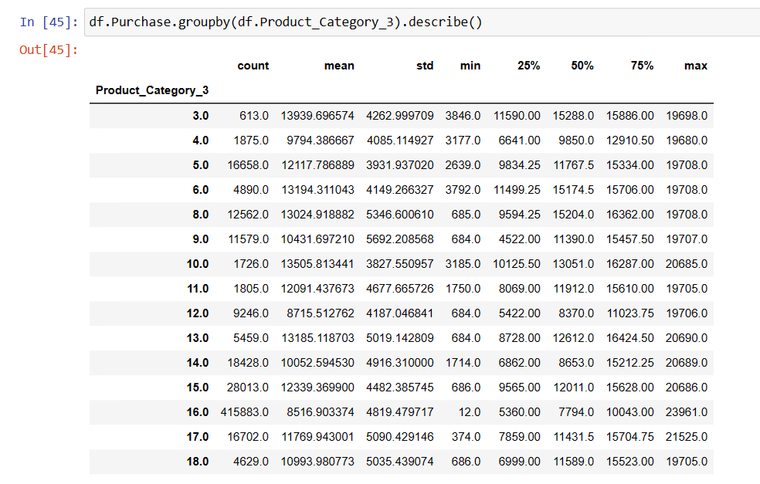

Slide 27
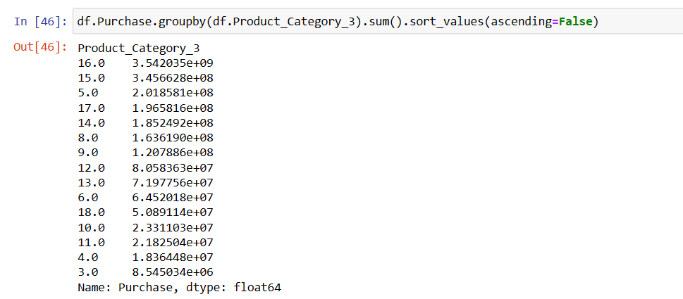

Slide 28
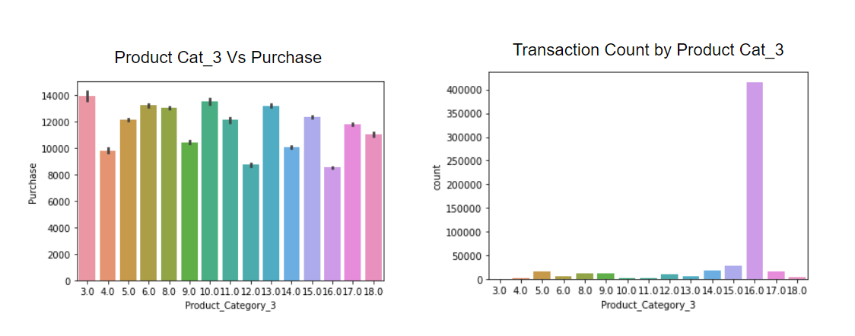
p-value 0.0 Good Predictor
Only Product 16 is working in this category

Slide 29
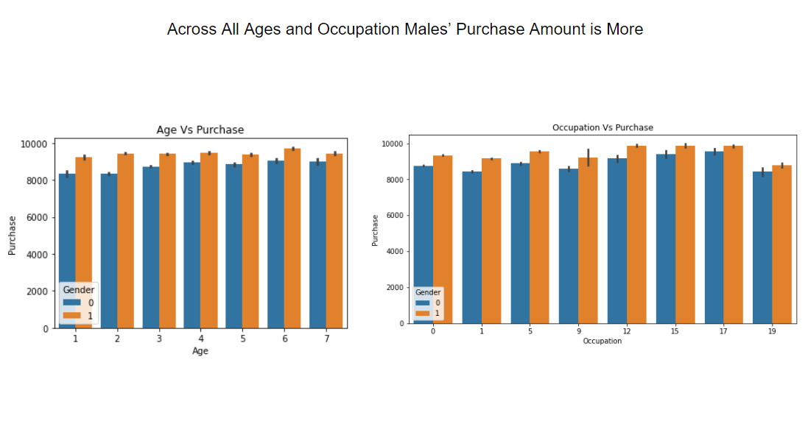

Slide 30
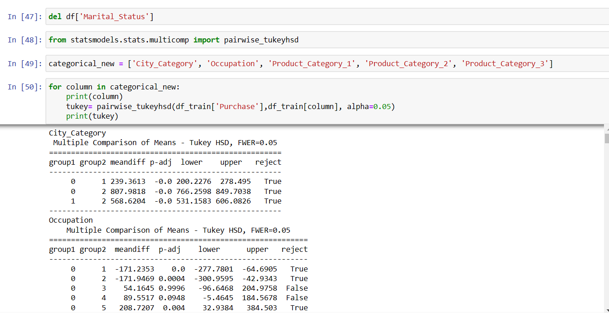

Slide 31
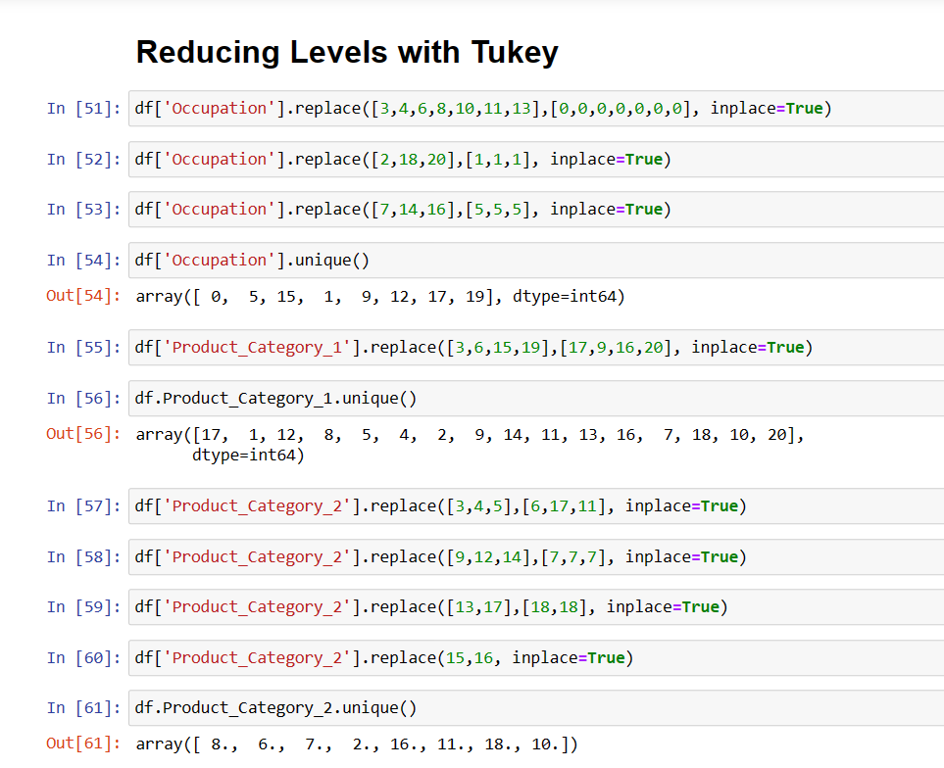

Slide 32
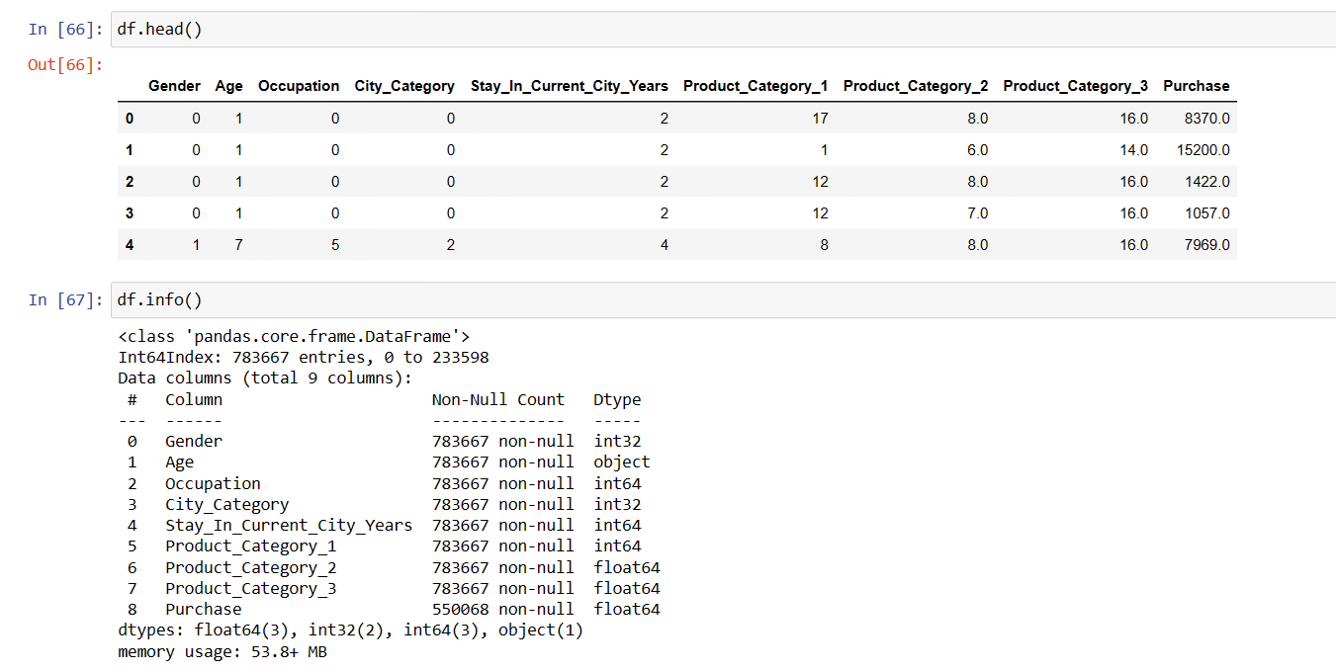

Slide 33
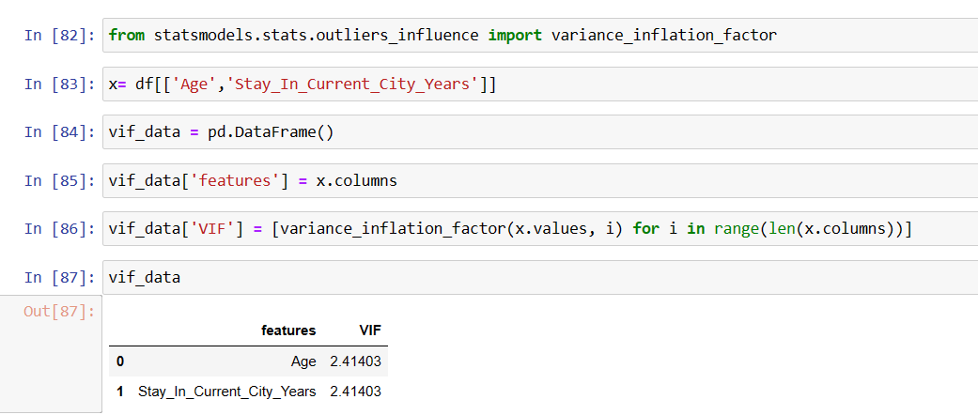

Slide 34
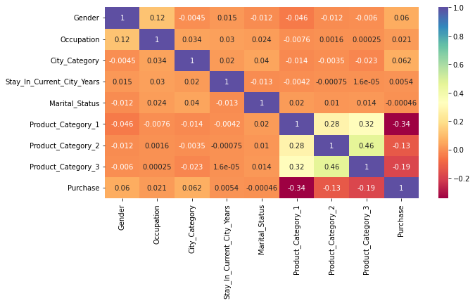

Slide 35
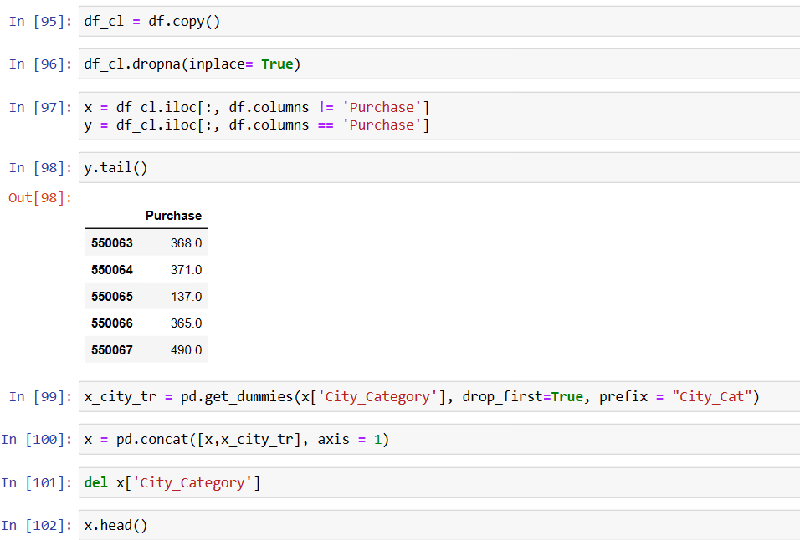

Slide 36
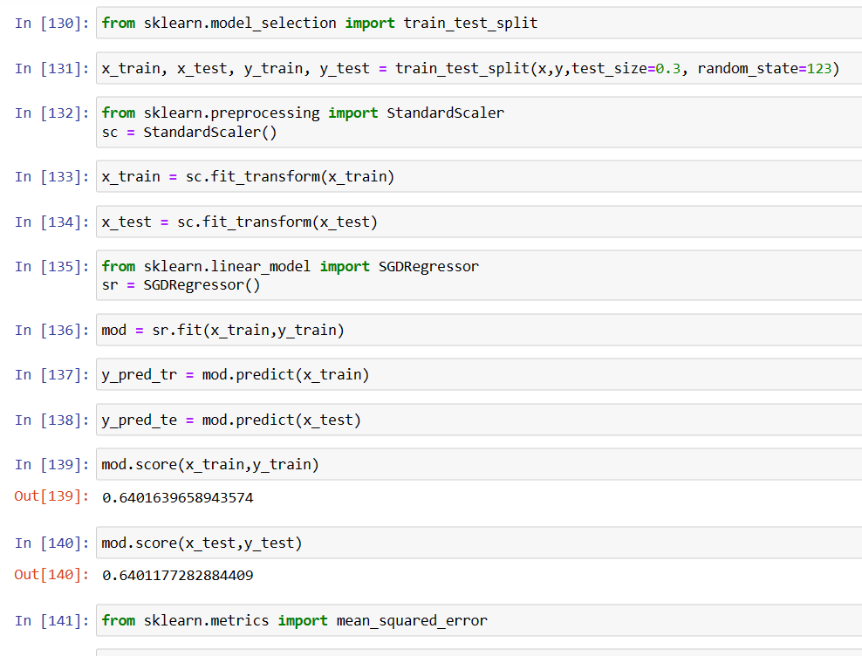
R-Square/Co-efficient of Determination of this model is 64.71% ie, 64.71% variance in Purchase amount can be explained with the model.

Slide 37
